Slide 1
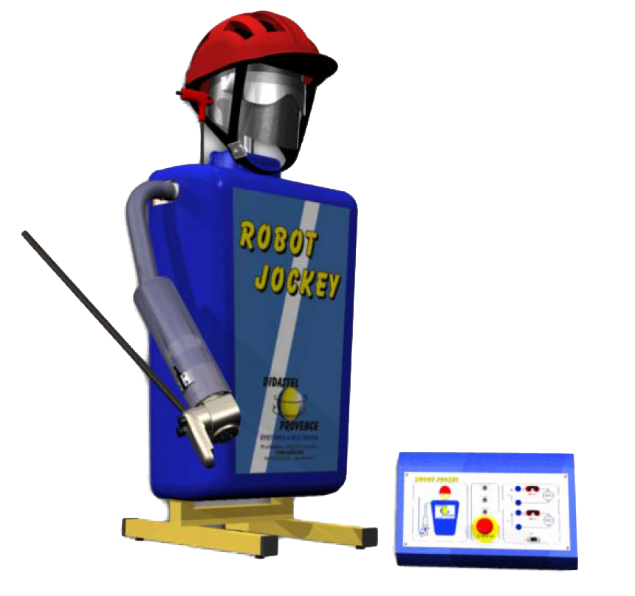
Dossier ressources
ILOT ROBOT JOCKEY

Slide 2
ILOT CORDEUSE

